Slide 1
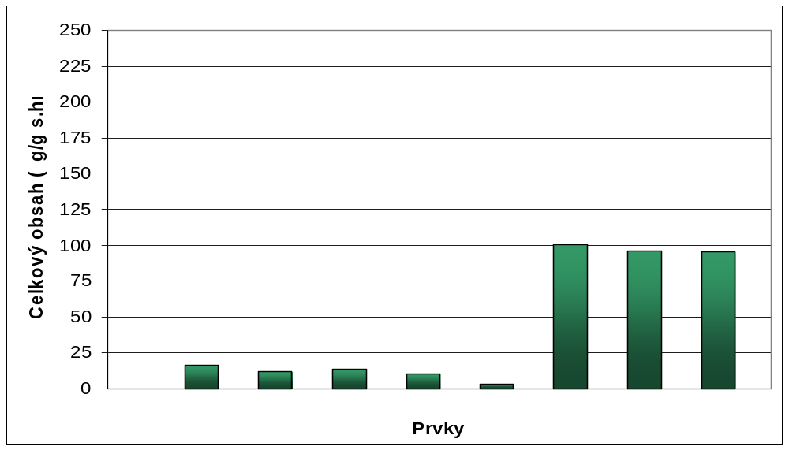
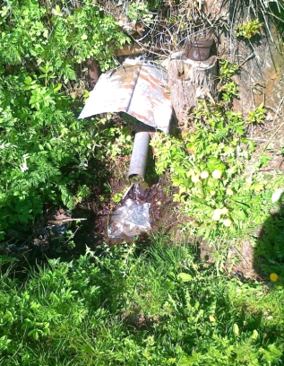
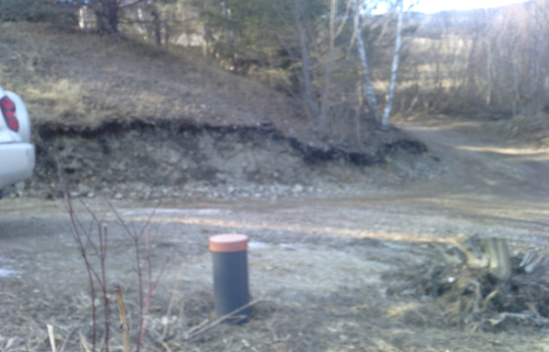
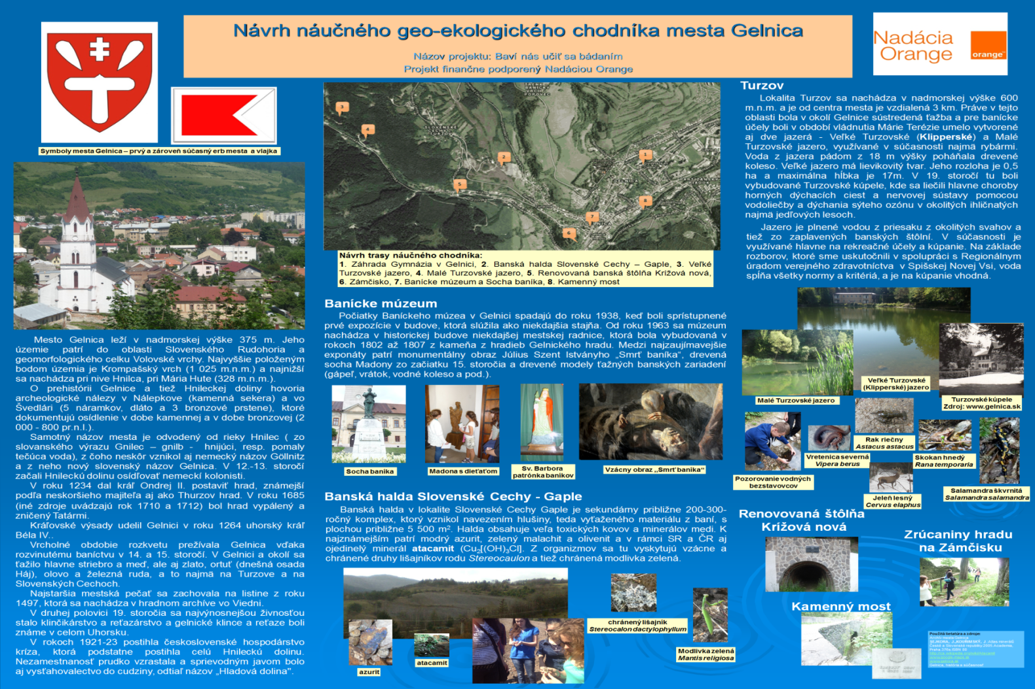
1.7 Metals content in lichen Cladonia arbuscula subsp. mitis
Since there is a high concentration of different toxic metals in the soil from the heap and being aware of a fact that lichens have an ability to accumulate metals from their environment, we examined presence and content of accumulated metals in the most common occurying lichen Cladonia arbuscula subsp. mitis. Detected content of the metals is to be seen in Graph 1.
Cu Zn Pb Ni Co Al Fe Sb
Graph 1 Content of toxic metals in lichen Cladonia arbuscula subsp. mitis
1.8 Physical properties and content of toxic metals in the water from the wells on and under the spoil heap
Temperature of the water taken from the well under the heap (sampling place no. 1) was 10°C and temperature of the water from the well on the heap (sampling place no. 2) was 7°C. pH properties were slightly acidic, with a value of pH 6,6 on the sampling place no. 1 and 6,9 on the sampling place no. 2. Hardness of the water sample from sampling place no. 1 was 2,92 mmol/l, whereas that of the water from sampling place no. 2 was 3,81 mmol/l.
Tab. 2 Content of metals in the sampling water
Element | Sampling place no. 1 | Samúpling place no. 2
Ba | 0,055 mg/l | 0,017 mg/l
Ca | 20,715 mg/l | 30,245 mg/l
Mg | 58,35 mg/l | 74,30 mg/l
K | 3,35 mg/l | 4,20 mg/l
Na | 9,97 mg/l | 6,14 mg/l
Li | <0,005 mg/l | <0,005 mg/l
Si | 2,56 mg/l | 2,85 mg/l
Sr | 0,077 mg/l | 0,090 mg/l
Al | <0,02 mg/l | <0,02 mg/l
Mn | 0,003 mg/l | 0,007 mg/l
Fe | 0,008 mg/l | 0,015 mg/l
Zn | 0,017 mg/l | 0,027 mg/l
Cu | 0,013 mg/l | <0,005 mg/l
Cr | <0,002 mg/l | <0,002 mg/l
Cd | <0,002 mg/l | <0,002 mg/l
Ni | <0,01 mg/l | 0,01 mg/l
Pb | <0,01 mg/l | <0,01 mg/l
Ag | <0,002 mg/l | <0,002 mg/l
Pic. 21 Sampling place no. 1
Pic. 22 Sampling place no. 2
1.9 Designing a geo-ecological pathway in Gelnica
The results, obtained by our obserbations, were summarized into the design of educational geo-ecological pathway in Gelnica. We designed information and educational table as a miniature of the pathway which is currently placed in the garden of local grammar school. We set out a route which includes the most interesting places from historical, geological, ecological and either recreational point of view.
Discussion
Mining heaps those of inhospitable conditions, insuffiency of water and humus and also they tend to be habitated by only very limited and specialized group of species. Weathering of the heap and creation of fine soil takes place very slowly (Banásová, 2003), which together with a complex of other unfavourable conditions results in its slow settlement either by animal of vegetation species.
Designated pH of the soil from the heap in Gelnica is 5,1, which is in correlation with findings of Banásová (2003), who examined the soil from the heap in Smolnícka Huta, where copper ores were mined, and found it to be 4,8 which is very close to our value obtained from the heap in Gelnica. This acidic pH is a result of presence of high amounts of sulfides in the soil. According to Banásová (2006), heaps with anomalous content of metals (e.g. Staré Hory, Gelnica, Smolník), are so-called ecological islands, since their very specific vegetation in comparison with their environment.
On the heaps in Slovakia we may find many rare and endangered species of lichens (Pišút a kol. (2001), we personally managed to detect presence of species from genus Stereocaulon – Stereocaulon tomentosum, S.dactyllophylum and Cladonia furcata, which into the category of Vulnerable.
Presence of lichens in such numbers might be, according to authors Lange and Ziegler (1963), explained by a fact that the pioneers do not have their optimal conditions here, but in comparison with other species they are strong and competitive.
Speaking of metals found in the most common lichen Cladonia arbuscula subsp. mitis, we were able to create the following list, starting with the most concentrated ones: aluminium, iron, antimony and copper. When we compare the content of the metals in lichen with that of the soil from the heap (Banásová, 2006 - Fe >> Cu >> As > Sb > Pb > Zn ) we might conclude that the lichen accumulated, with an exception of aluminium, the most concentrated metals in the soil.
Conclusion
Habitation of the heap is, in terms of variety of species, very limited. Total coverage of the heap is around 40%. Its soil is characterized by an acidic pH. The most common species which can be found on the mining heap in Gelnica, location Slovenske Cechy-Gapsle, is Agrostis capillaris. Quite frequent are also Betula pendula and Pinus sylvestris, with visibly impaired vitality. Moreover, another common species to be found on the heap are certainly lichens - Cladonia arbuscula subsp. mitis and protected species Stereocaulon dactylophyllum. Altogether, we were able to identify 8 representatives of fungi – the most common one was Suillus luteus, which can be found primarily in the central parts of the heap. Most of the permanent habitants are invertebrates – we may spot here even protected species of Mantis religiosa. Elements with the highest concentration in the lichen Cladonia arbuscula subsp. mitis were aluminium, iron, antimony and copper. Presence of toxic metals in the analyzed lichens is corresponds and is caused by the content of the metals in the soil of the heap. Amount of the metals in the water taken from both sampling places, with an exception of content of calcium, meets the standards set by Government Regulation of SR.

